Slide 1


INVESTMENT-READY INDUSTRIAL SITE

Slide 2
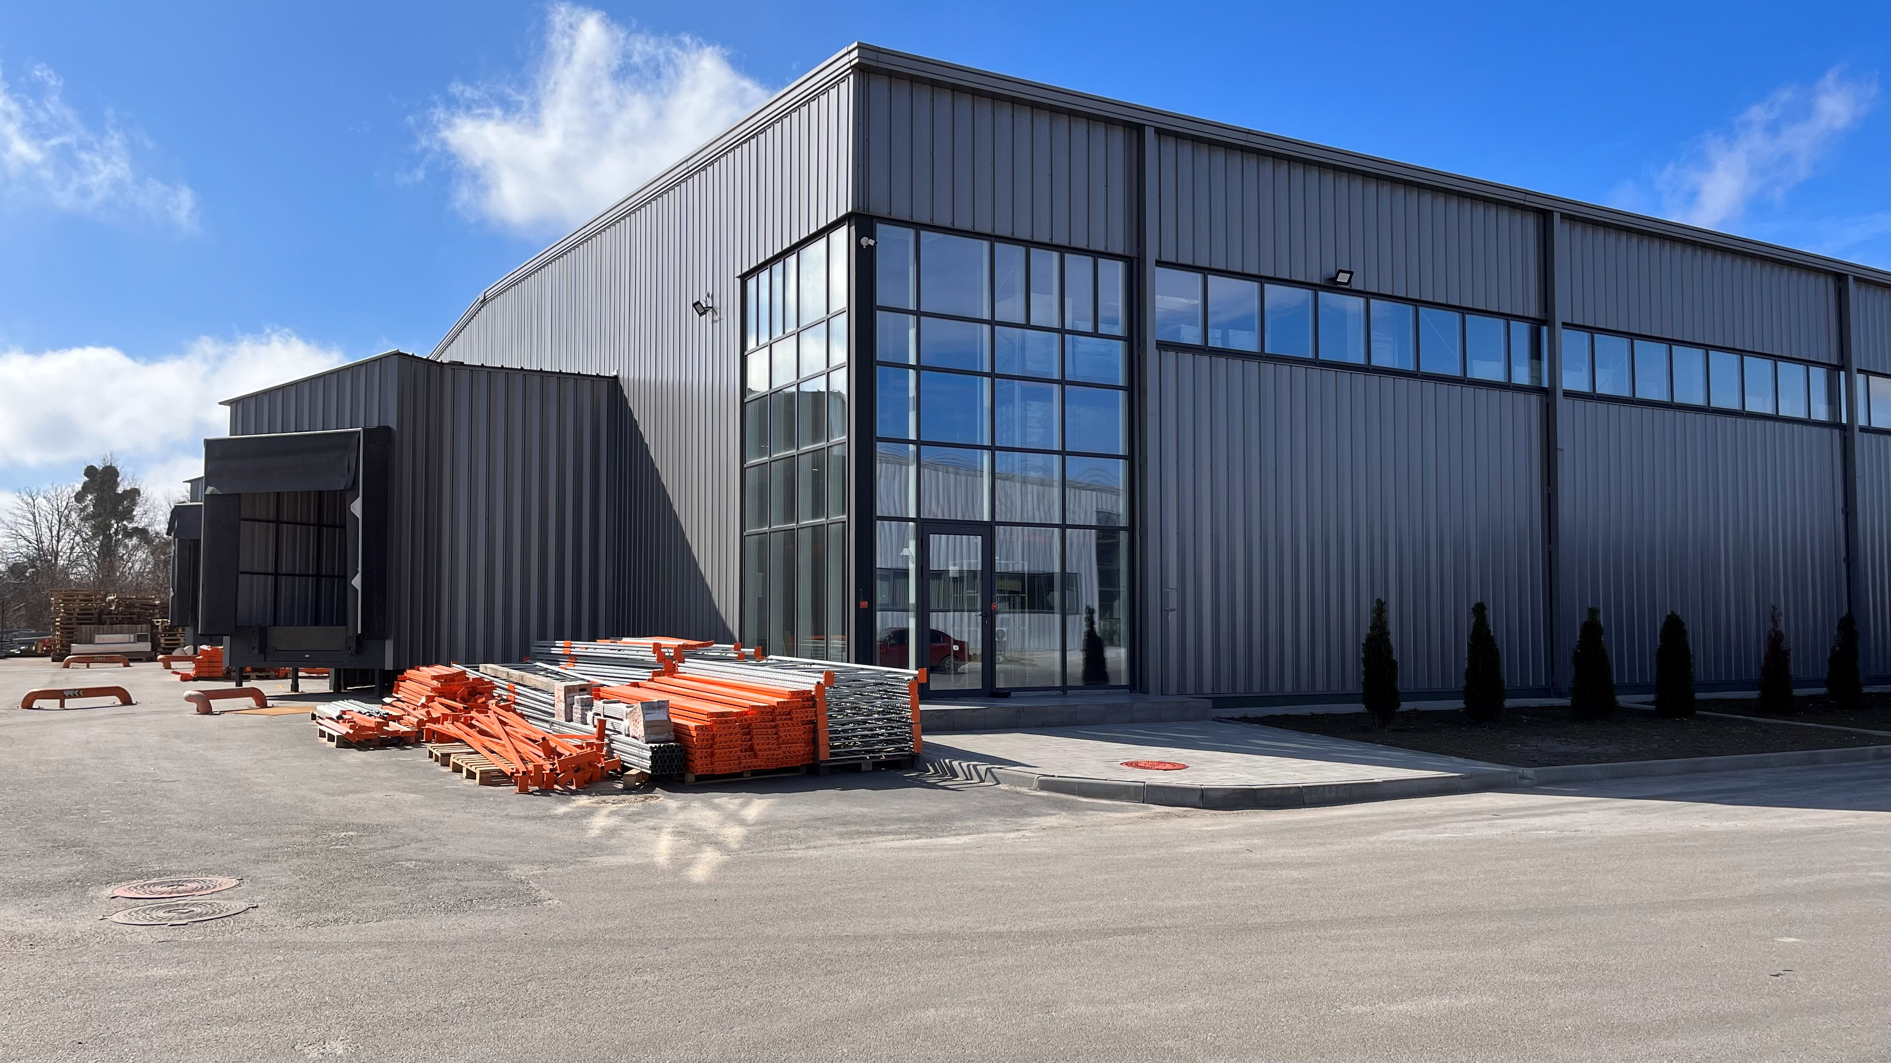
BILA TSERKVA INDUSTRIAL PARK
RESULTS ’25
703,100 m²
total area of ​​land used
450,060 m²
land plots developed/under construction/sold
>20
existing residents
64%
235,400 m²
total area of ​​constructed buildings and premises
86,900 m²
industrial and warehouse real estate put into operation
37%
We are a team of professionals who develop infrastructure and create conditions for sustainable industrial development of Ukraine.
MISSION
$250
million investments attracted
$89
million investments attracted
36%
16/06/2026
Industrial Park Bila Tserkva

Slide 3
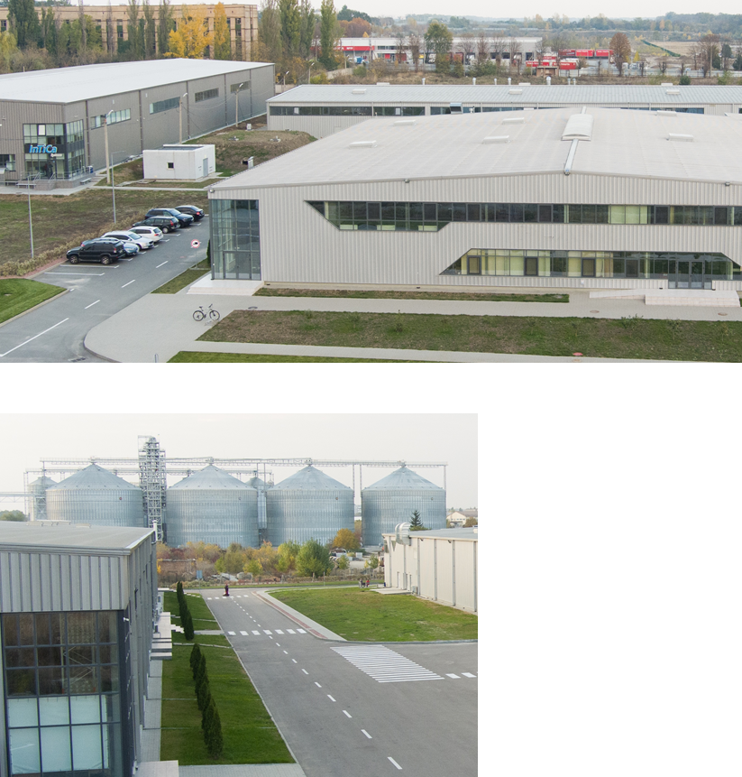
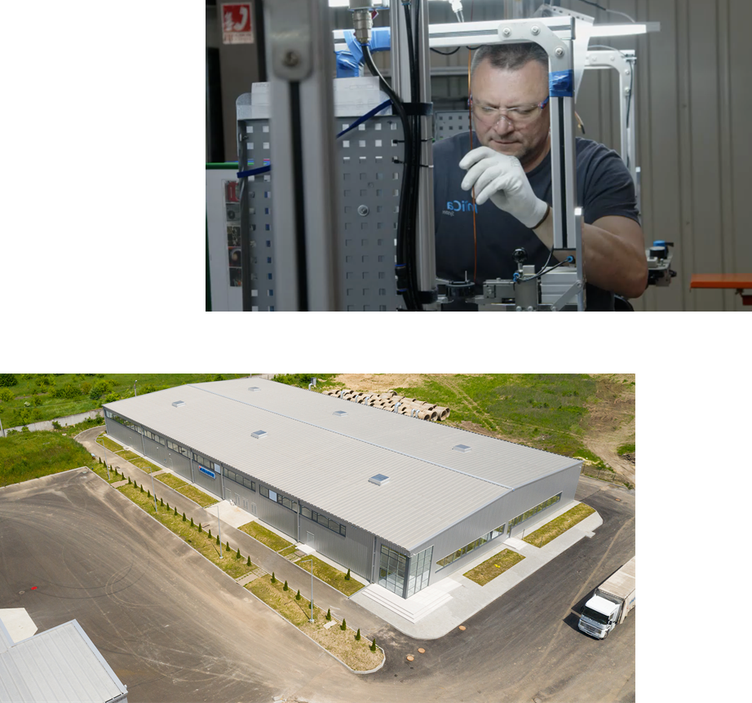
OUR ACHIEVEMENTS
15
Production and warehouse facilities
30
690
construction site according to plan
New jobs
22
Kilometers of utility networks laid
27 000
Asphalt roads and sidewalks were built
16/06/2026
Industrial Park Bila Tserkva

Slide 4

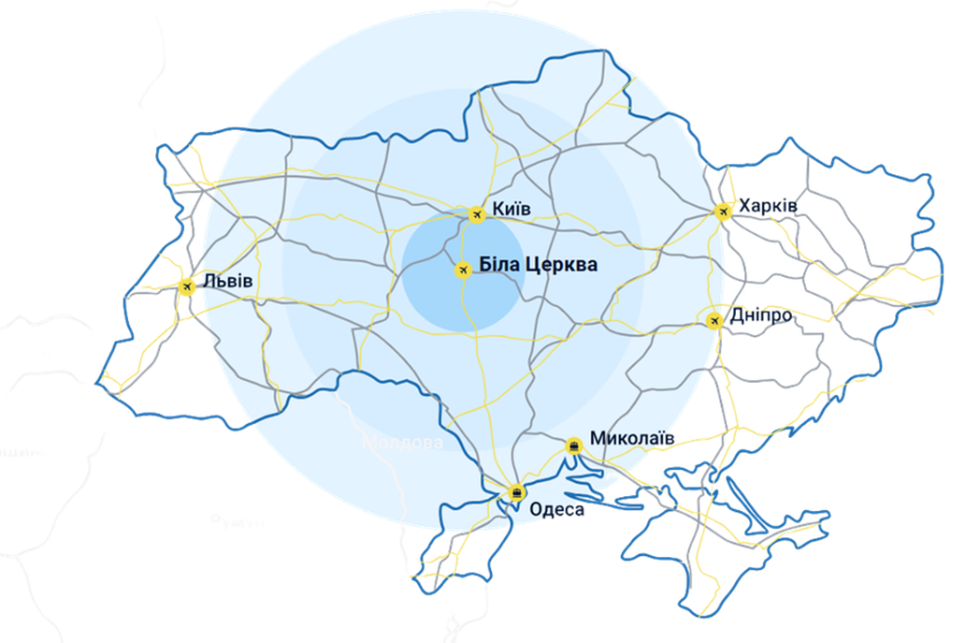
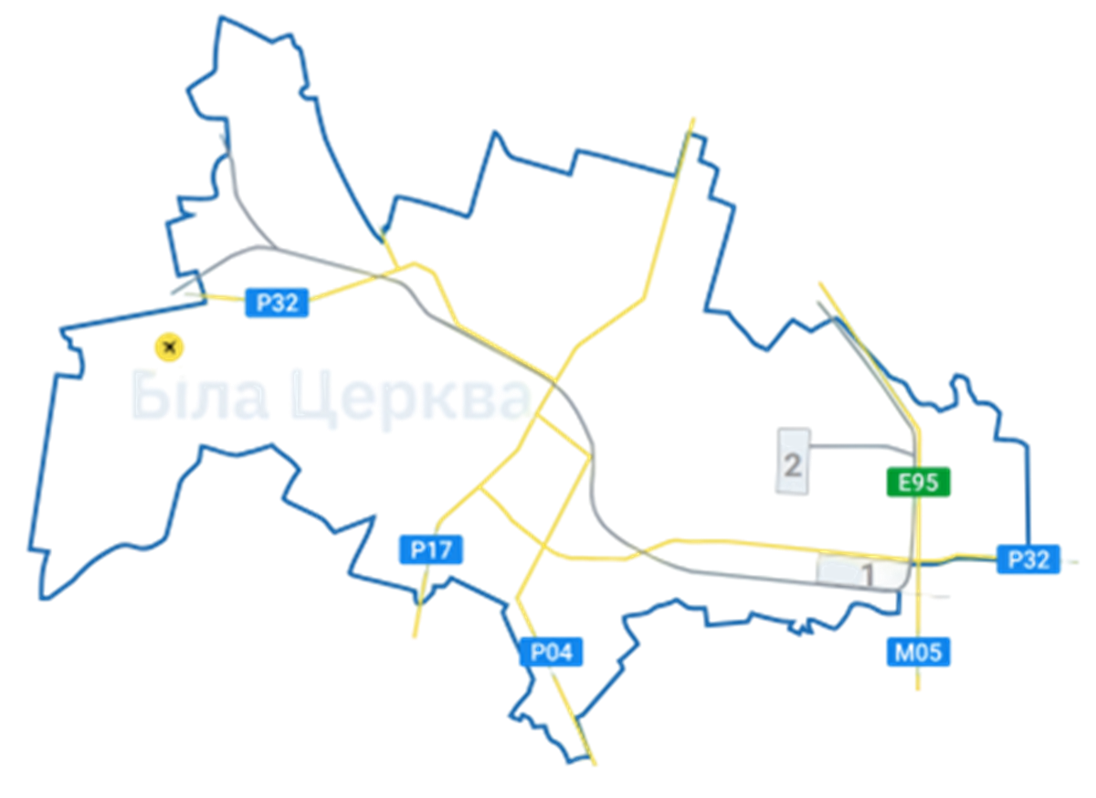
LOCATION OF THE INDUSTRIAL PARK
Distance from Kyiv – 75 km
(E95) Helsinki – Kyiv – Alexandroupolis
(P32) Kremenets – Bila Tserkva
(P04) Kyiv – Fastiv – Bila Tserkva
(M05) Kyiv – Odesa
Boryspyl International Airport
Belotserkva cargo aviation complex
Labor market:
Population – 310 thousand
Specialists and technicians – 150 thousand
16/06/2026
Industrial Park Bila Tserkva

Slide 5
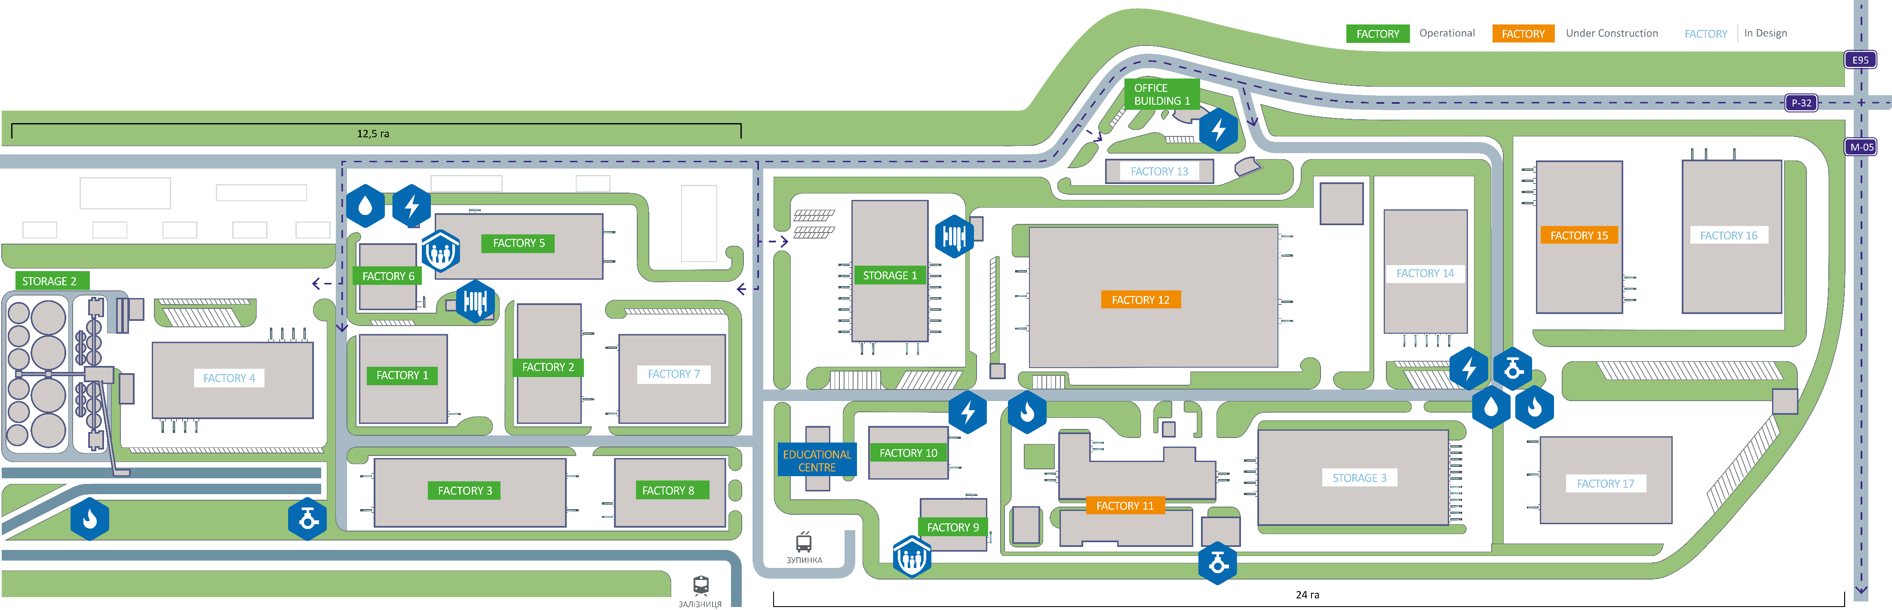




INDUSTRIAL PARK PLAN
1st PHASE NOW
Electricity
Gas
Water supply
Sewerage
Power: 8 MW
Voltage: 10 kV;
Distance: 0 m;
Additional power: 10 MW*.
Capacity: 8,400 m³/h;
Distance: 0 m;
Pipe diameter: 310 mm.
Capacity: 1,300 m³ /day;
Distance: 0 m;
Pipe diameter: 2x160 mm.
Capacity: 1,300 m³ /day;
Distance: 0 m;
Pipe diameter: 2x110 mm.
*Status: technical conditions received; design developed; materials partially ordered.​
16/06/2026
Industrial Park Bila Tserkva

Slide 6
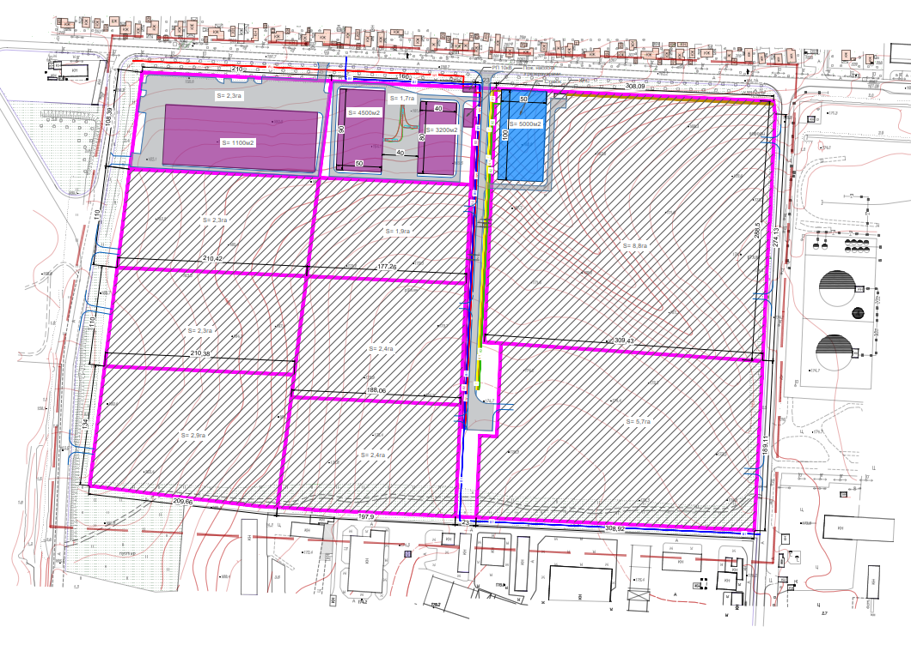







INDUSTRIAL PARK PLAN
2 ND PHASE NOW
Electricity
Capacity: 15 MW;
Voltage: 10 kV;
Distance: 0 m;
Status: under construction (due for completion in Q32026).
Gas
Capacity: 10 thousand m³/h;
Distance: at the border of the site;
Pipe diameter: 300/400 mm.
Water supply
Capacity: 1224 m³/day;
Distance: 0 m;
Pipe diameter: 2x160 mm.
Status: under construction (to be completed in 2Q2026)
Sewerage
Capacity: 900 m³/day;
Distance: 0 m;
Pipe diameter: 2x160 mm.
Status: under construction (to be completed in 3Q2026)
16/06/2026
Industrial Park Bila Tserkva

Slide 7
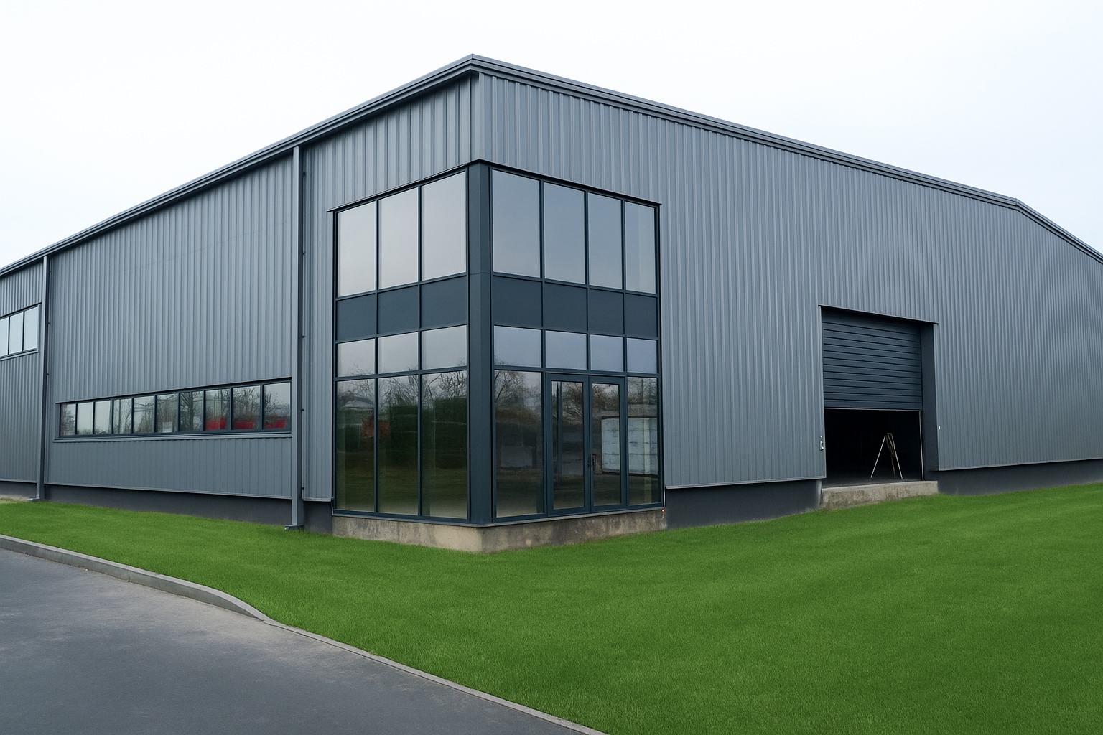




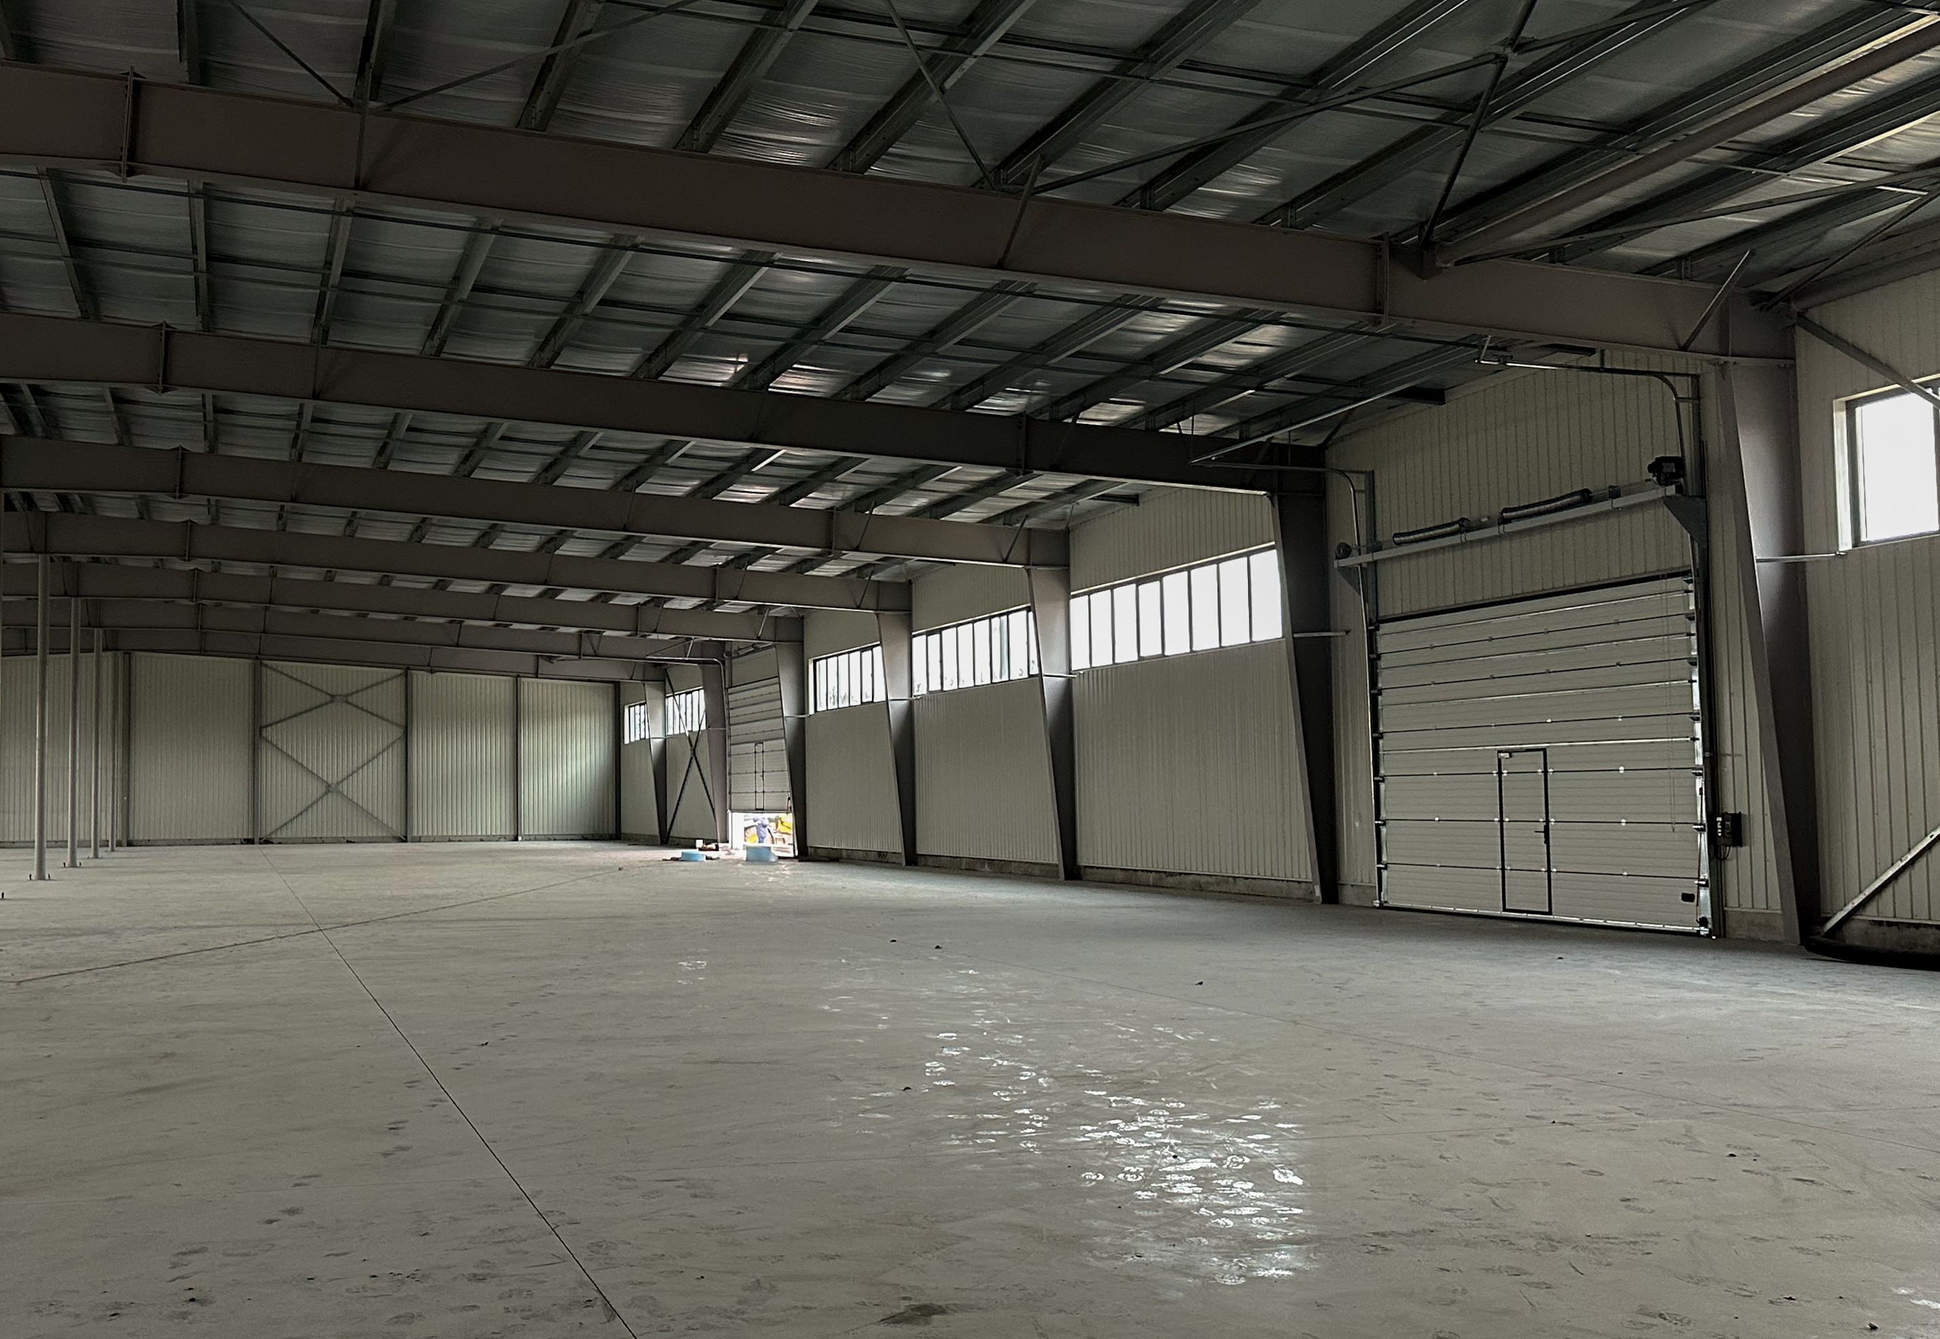
Completed INDUSTRIAL FACILITY
3 200 sq.m.
Frame
Production, warehouse, technical and office premises
Astron Steel (Luxembourg)
Walls and roof
6 m.
Prefabricated sandwich panels with heat and sound insulation properties
Minimum height 6 m
Maximum height 7.5 m
Three gates
The building is equipped with three industrial sectional doors
Load capacity 4t/m on a self-leveling floor
16/06/2026
Industrial Park Bila Tserkva
7

Slide 8
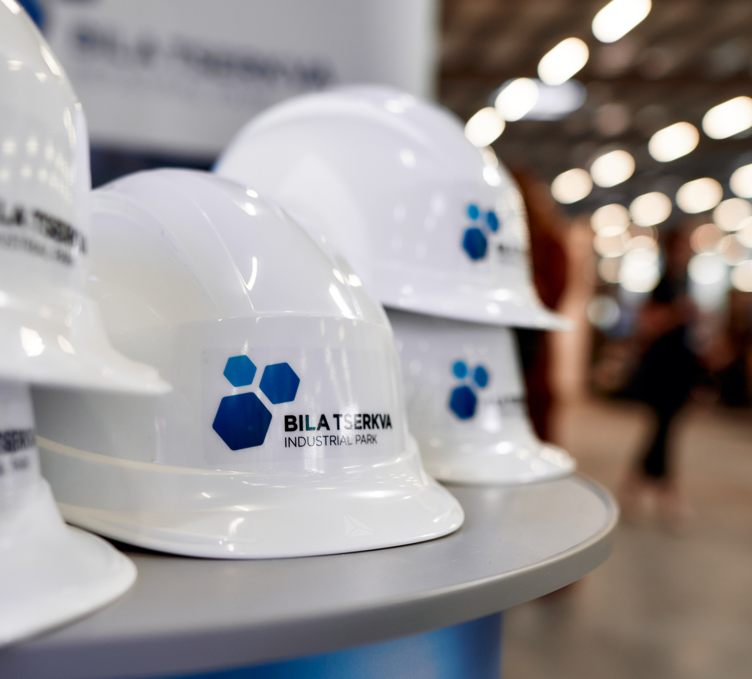
Benefits for residents
A
Reducing investment risks.
Developed production and transport infrastructure.
Partnership and acceleration programs.
Creating optimal supply chains.
Developing a sustainable ecosystem that reduces negative environmental impact, reduces energy and raw material consumption, and provides decent working conditions.
B
C
D
E

Slide 9
INVESTMENT STATE Incentives
Benefits for Residents
VAT on import
А
Compensation for utility costs
Compensation of loan interest
Exemption from compensation for forestry losses
Exemption from real estate tax
Reduction in land tax
0%
Exemption from import VAT on new equipment for operations in an industrial park.
B
Import duty
C
0%
Exemption from import duty on equipment and materials for activities in the industrial park.
D
E
Corporate income tax
0%
Exemption from income tax for 10 years from the date of receiving the first profit.
16/06/2026
Industrial Park Bila Tserkva

Slide 10
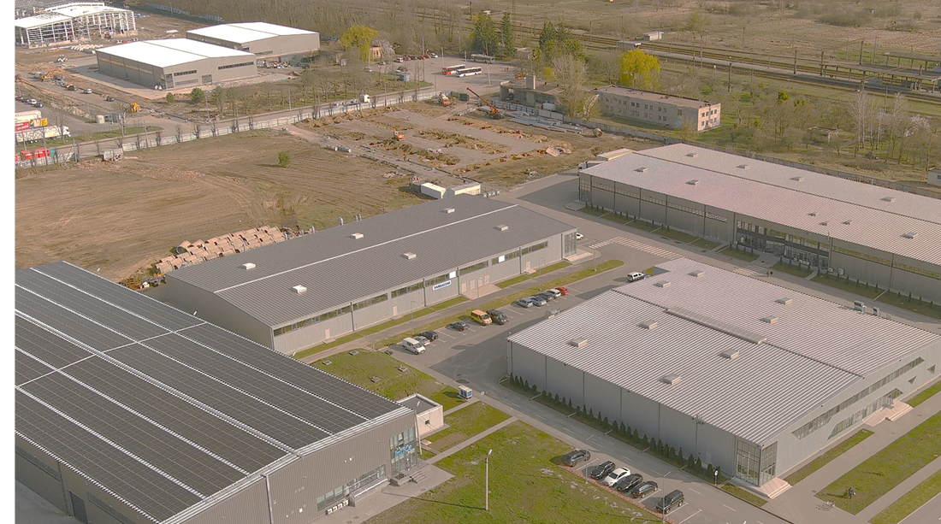
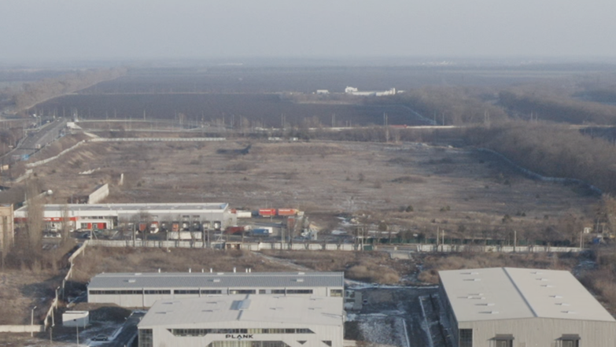
Our commercial / investment offer
Land plots with utilities
Private land is available for sale or lease, depending on the client's needs.
Custom-made industrial and logistics facilities
Construction of facilities according to the client's specifications - available for purchase or rent.
Ready-made industrial facilities
Private industrial properties offered for sale or lease.
Turnkey project development and construction management
Comprehensive support for planning, design and implementation of industrial and logistics projects.
A full range of business services in one place
Assistance with permits, business registration, product certification and other regulatory procedures.
Integrated operational services
Provided by the management company of the industrial park: security, maintenance of infrastructure and facilities, HR support, implementation of LEAN practices.
Land bank or joint projects/co-investment opportunities
Proposals for the purchase of land assets or the creation of joint ventures within the industrial park.
16/06/2026
Industrial Park Bila Tserkva
10

Slide 11

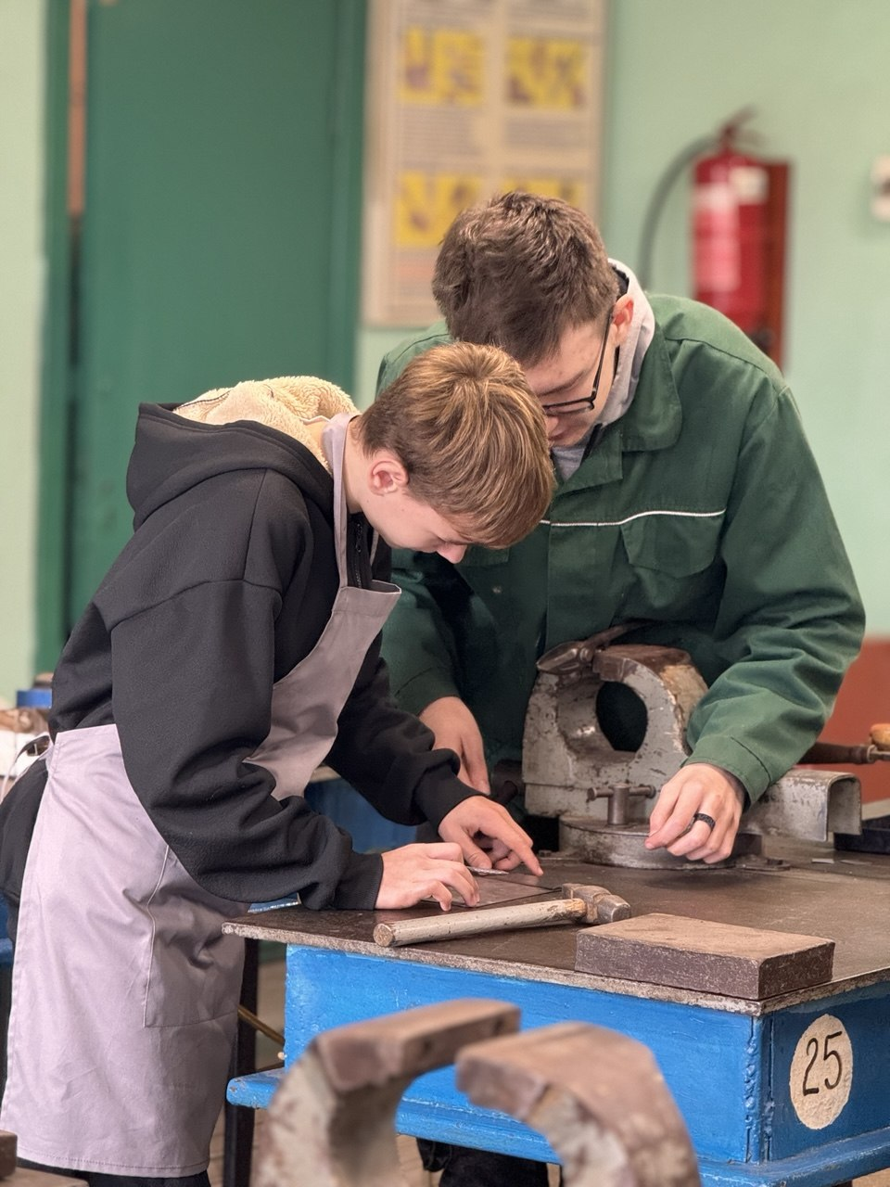

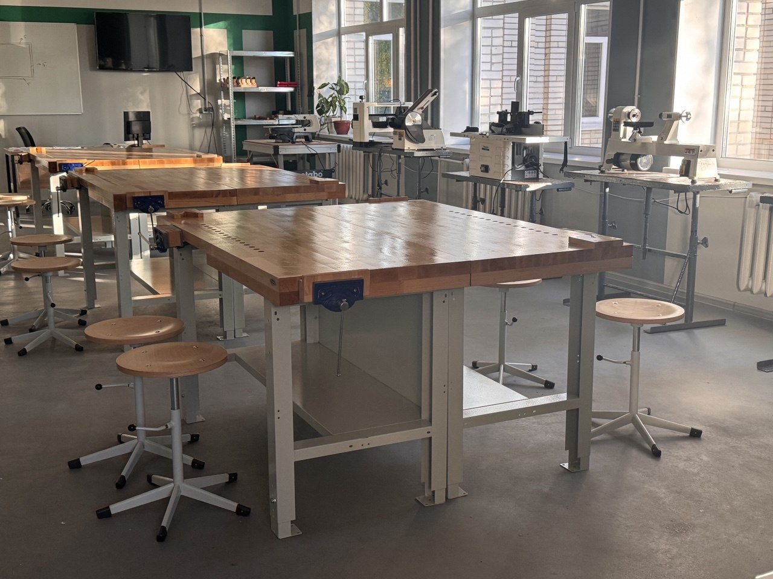


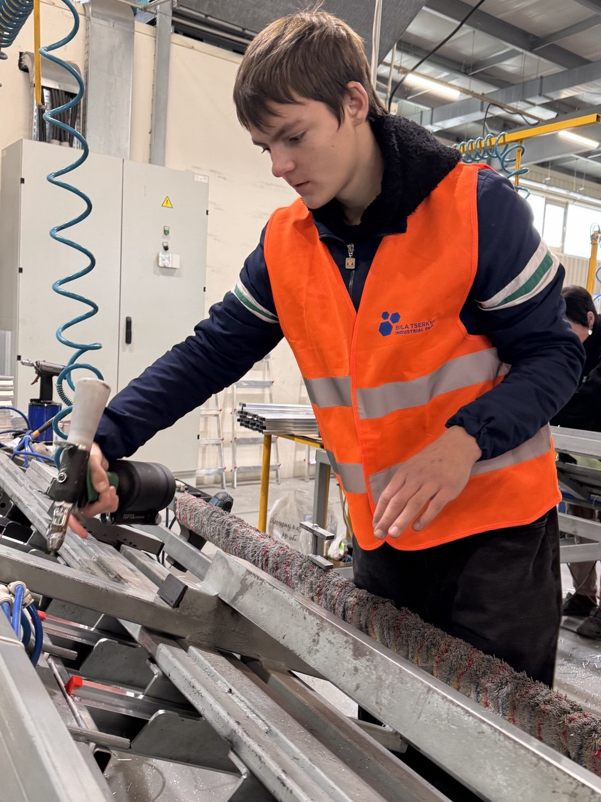


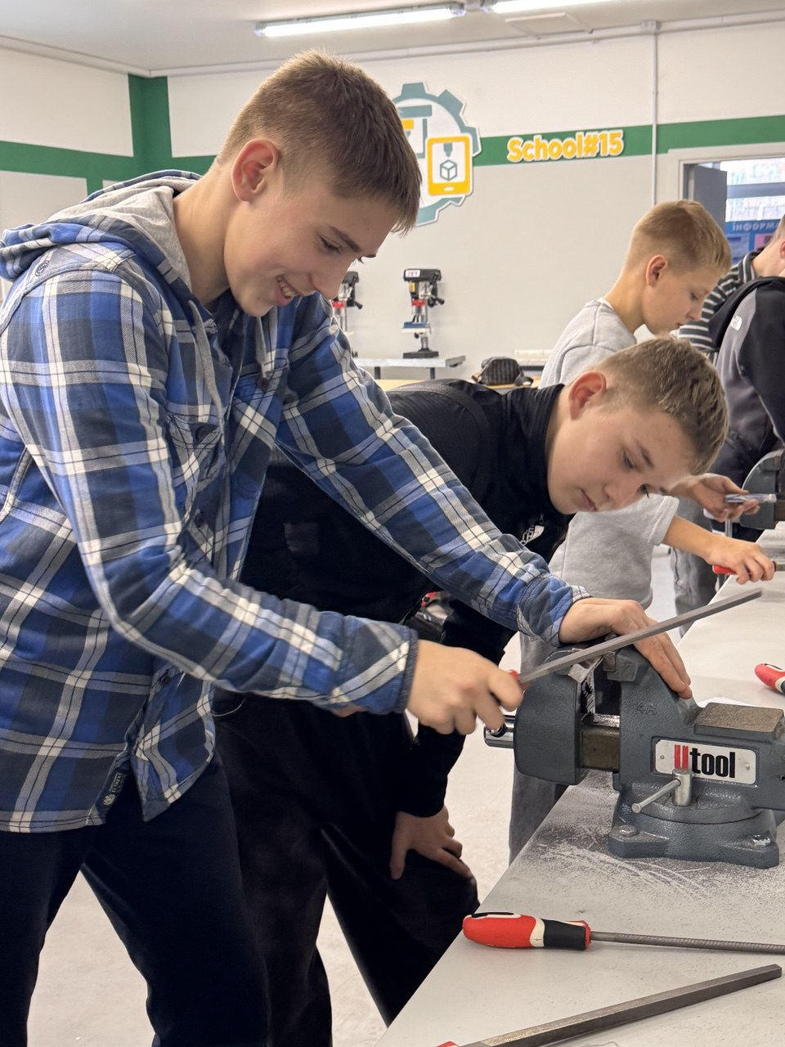
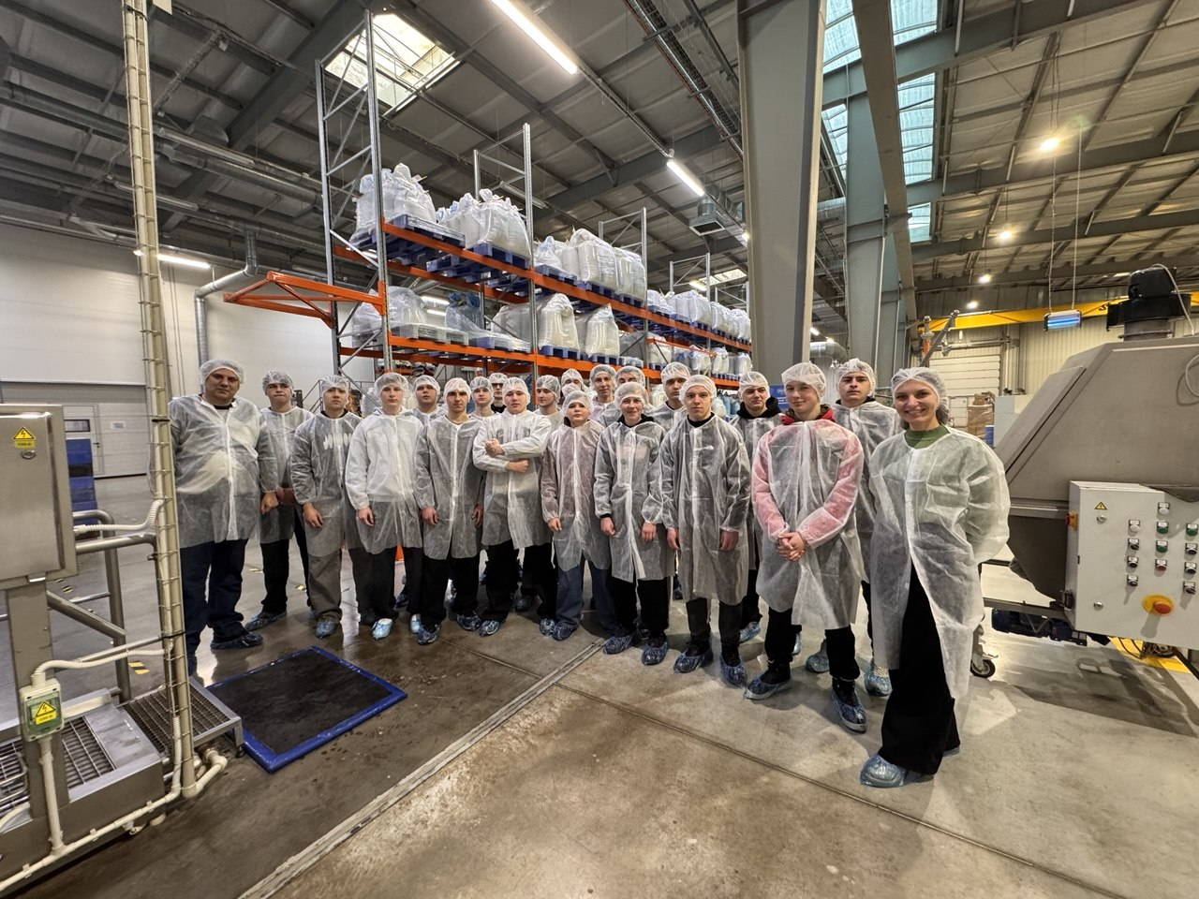
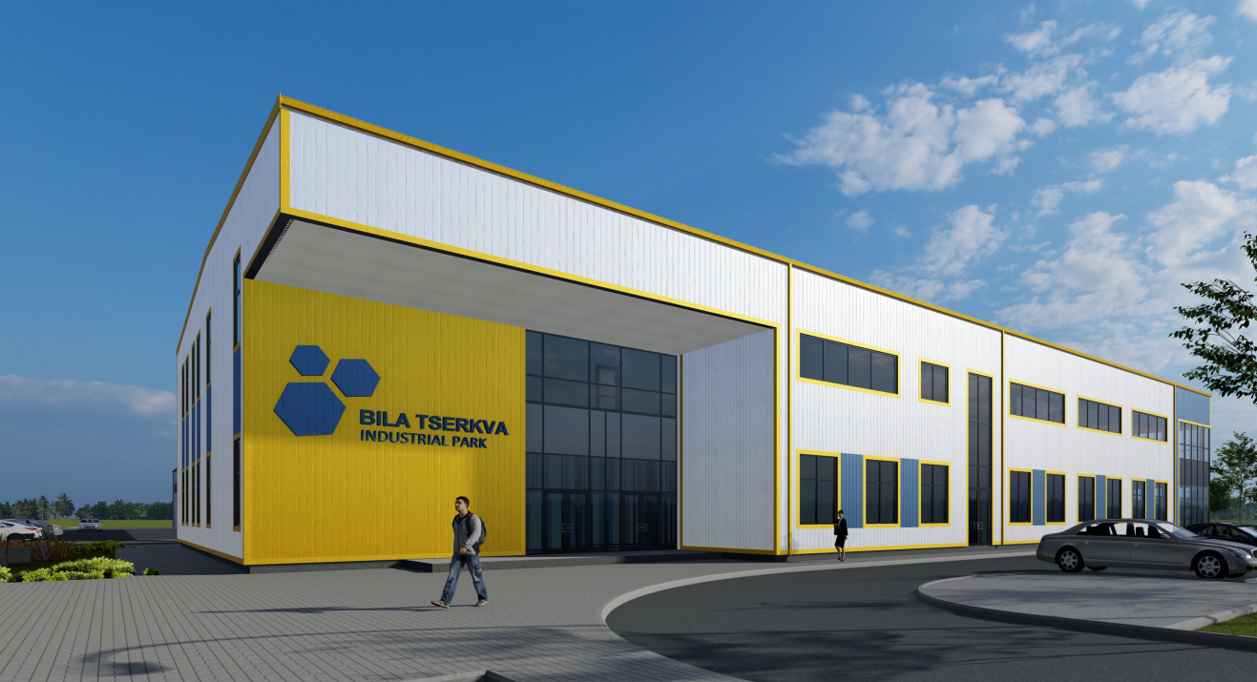
К’єрний шлях у робітничих професіях:
від учня до висококваліфікованого спеціаліста
STRATEGIC INTERACTION MODEL FOR PERSONNEL STABILITY
Industrial Vocational College
GYMNASIUM
Updated work offices – for a space to choose a profession
COLLEGE
Education: dual/individual education
IP-BT
Modern equipment and machines purchased
Internship/Employment
100% cooperation with all institutions
Career guidance
Gymnasium
GYMNASIUM
COLLEGE
PRACTICE
EMPLOYMENT
The ecosystem of human capital development: from high school to industry 4.0
16/06/2026
Industrial Park Bila Tserkva
16/06/2026
Industrial Park Bila Tserkva

Slide 12




CONTACTS
Kyiv region, Bila Tserkva city, Nezalezhnosti avenue, 66-D
Email: info@ip-bt.com
BilaTserkvaIP Bila-Tserkva-Industrial-Park-1
@bilatserkvaindustrialpark1

Slide 13
BACKUP

Slide 14

Completed INDUSTRIAL FACILITY
^{LOCAL TAX RATES}
Industrial real estate for own needs | ^{0%}
^{Industrial property for rent} | 0,85% from the minimum wage per m2
^{Local industrial land tax} | ^{€ 2,890/ha per year}
Industrial land tax in an industrial park | ^{0%}
Equity participation in construction | ^{0%}
^{SALARY TAXATION STRUCTURE}
^{Salary including taxes} | ^{€ 530,5}
Social Security (paid by the employer) | ^{22 %}
Personal income tax (paid by the worker)) | ^{18 %}
^{ВЗ (paid by the worker)} | ^{1,5 %}
^{Salary excluding taxes} | ^{€ 350}
^{ON-SITE LABOR COST}
 |  | ^{Salary without taxes,} ^{per month} | ^{Salary with taxes,} ^{per month}
^{MANAGER} Master of Engineering, 5 years of work experience, fluent English |  | ^{≥ € 900} | ^{≥ € 1364}
^{ENGINEER} Master of Engineering, 3-5 years of work experience, basic English |  | ^{≥ € 600} | ^{≥ € 909,3}
^{WORKER} College, 3 years of work experience or more |  | ^{≥ € 350} | ^{≥ € 530,5}
^{COST OF MUNICIPAL SERVICES}
 | ^{NETWORKS} | ^{PRICE, excluding VAT}
 | ^{Electricity supply} | ^{market}
 | ^{Natural gas} | ^{market}
 | ^{Water supply} | ^{€ 0,35/м³}
 | ^{Drainage} | ^{€ 0,5/м³}
16/06/2026
Industrial Park Bila Tserkva

Slide 15
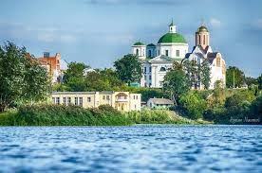
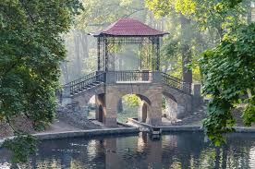
BILA TSERKVA - A CITY FOR BUSINESS AND LIFE
Developed urban infrastructure: public transport, medical facilities, modern housing, banks and services - everything necessary for the daily life of workers.
Technical and vocational education system: colleges, vocational education and training of specialists for manufacturing enterprises.
Powerful industrial base: a city with a history of production and the presence of an experienced workforce.
Comfortable environment: favorable living conditions for workers, their families and relocation of specialists.
One of the key industrial centers of the Kyiv region with the potential for business scaling.
16/06/2026
Industrial Park Bila Tserkva

Slide 16
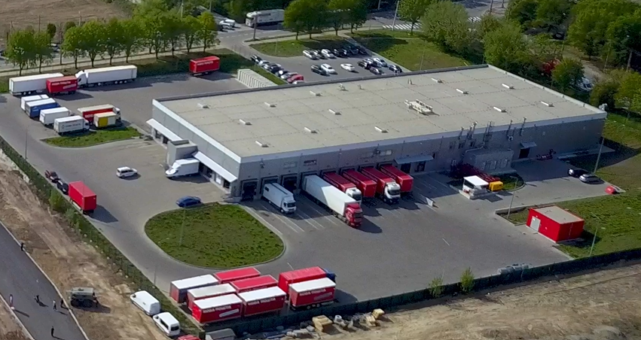
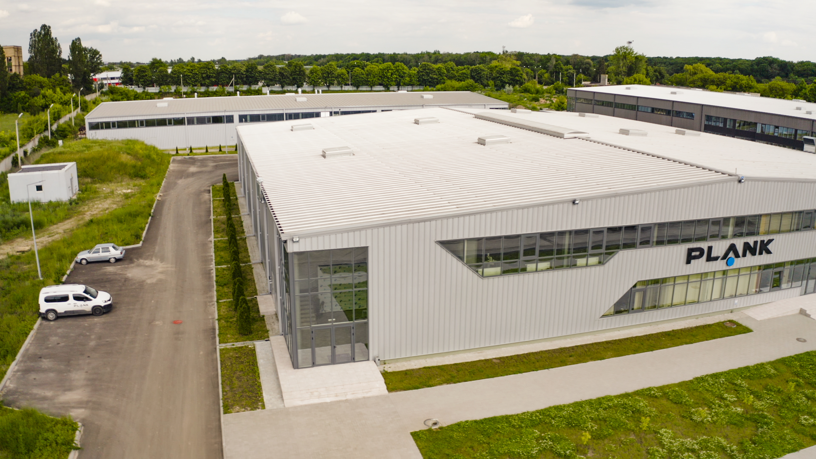
CUSTOM BUILT PROJECTS
NP
PLANK ELECTROTECHNIC
Innovative logistics center in Bila Tserkva
Ukrainian manufacturer of electrical installation systems
Modern building with a total area of ​​3900 m².
Automated sorting line using machine learning technologies, capable of processing over 3 thousand shipments per hour. Central office and customer service center in the region. Commissioned in Q3 2020.
Modern building with a total area of ​​3600 m². Heating using heat pumps combined with heat recovery from equipment, automated metering and remote access systems. The building is certified according to the BREEAM standard (high level of energy efficiency, environmental friendliness and comfort for personnel). Commissioned in the 2nd quarter of 2019.
16/06/2026
Industrial Park Bila Tserkva

Slide 17
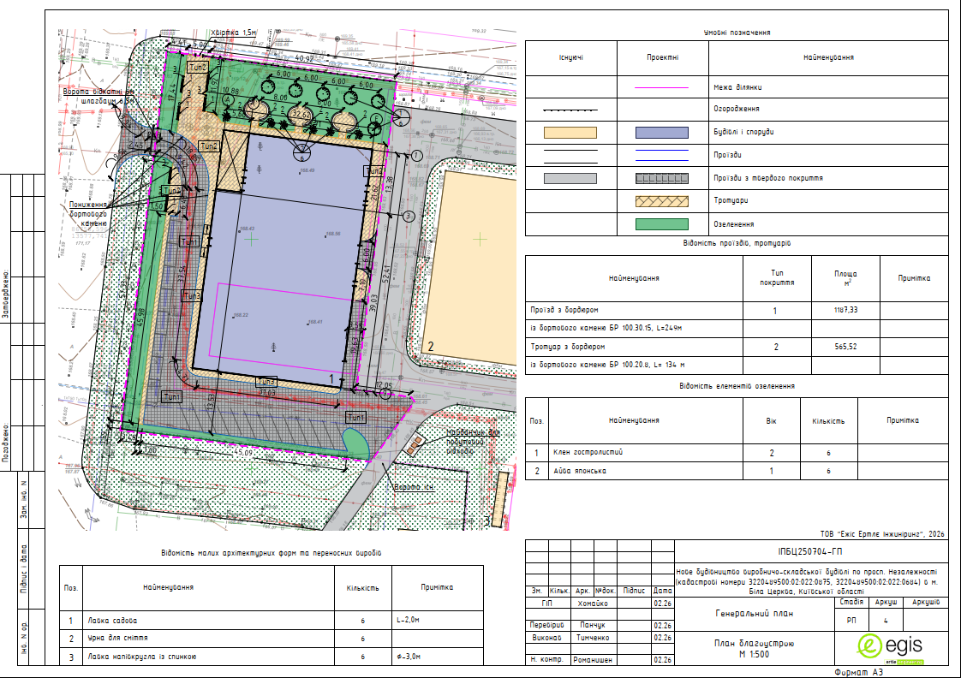
Educational center
PLAN
16/06/2026
Industrial Park Bila Tserkva

Slide 18
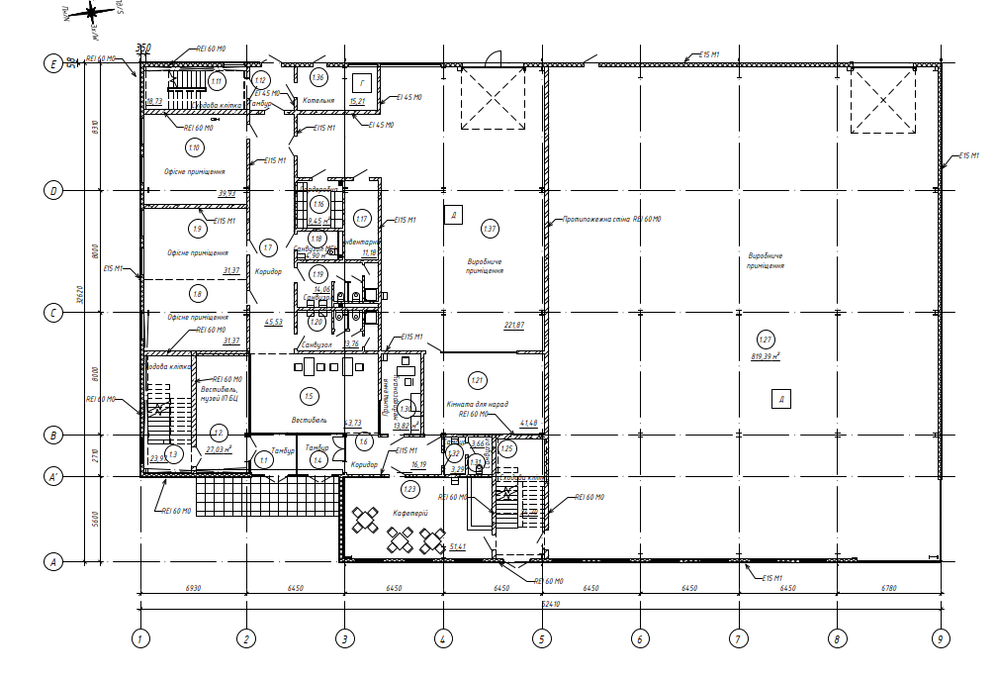
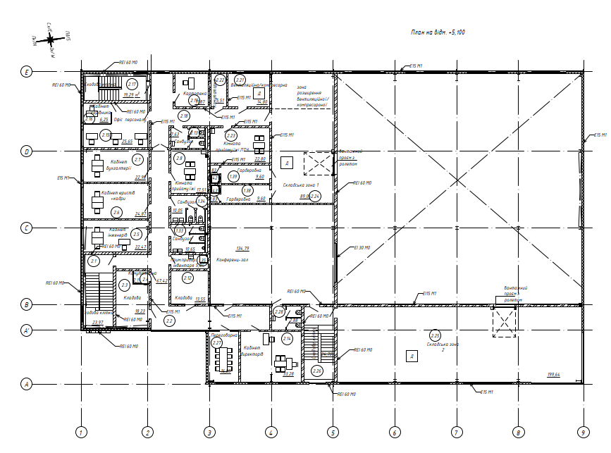
Educational center
Floor plans
16/06/2026
Industrial Park Bila Tserkva

